Slide 1


The Power of Certification Credentials
Why ICF Certifcation is important and empoweringl

Slide 2
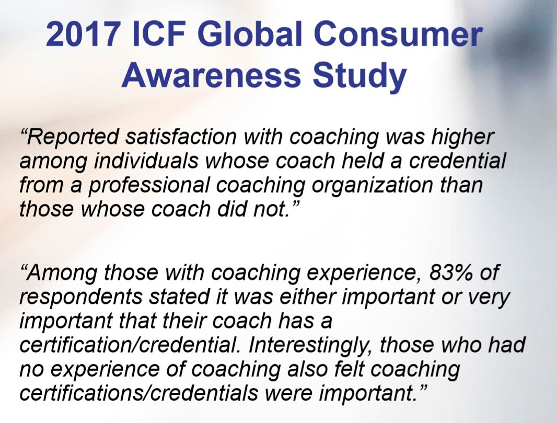

Slide 3
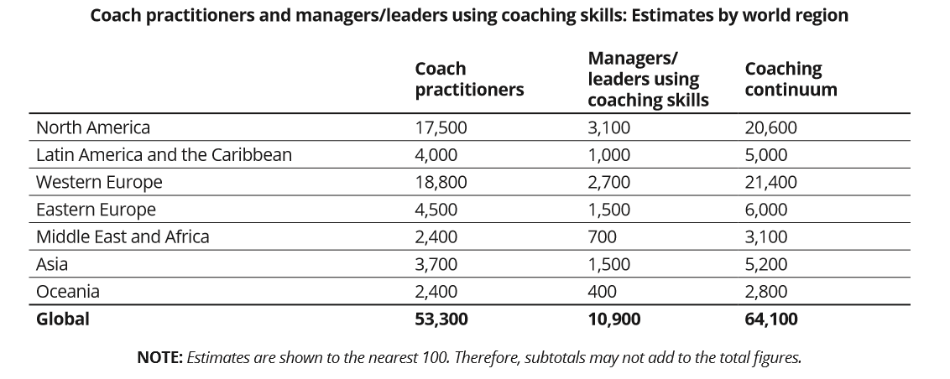

Slide 4
PROBLEM
ICF
Certification
Statistics
READ
ACC
16,465
PCC
10,836
October 15, 2019
MCC
1,150

Slide 5
ICF 2015 Global Study
Higher Reported Revenue
  Compared to a peer without a credential, credentialed coach practitioners
  Command higher fees from coaching
  Report more clients and greater annual revenue from coaching

Slide 6
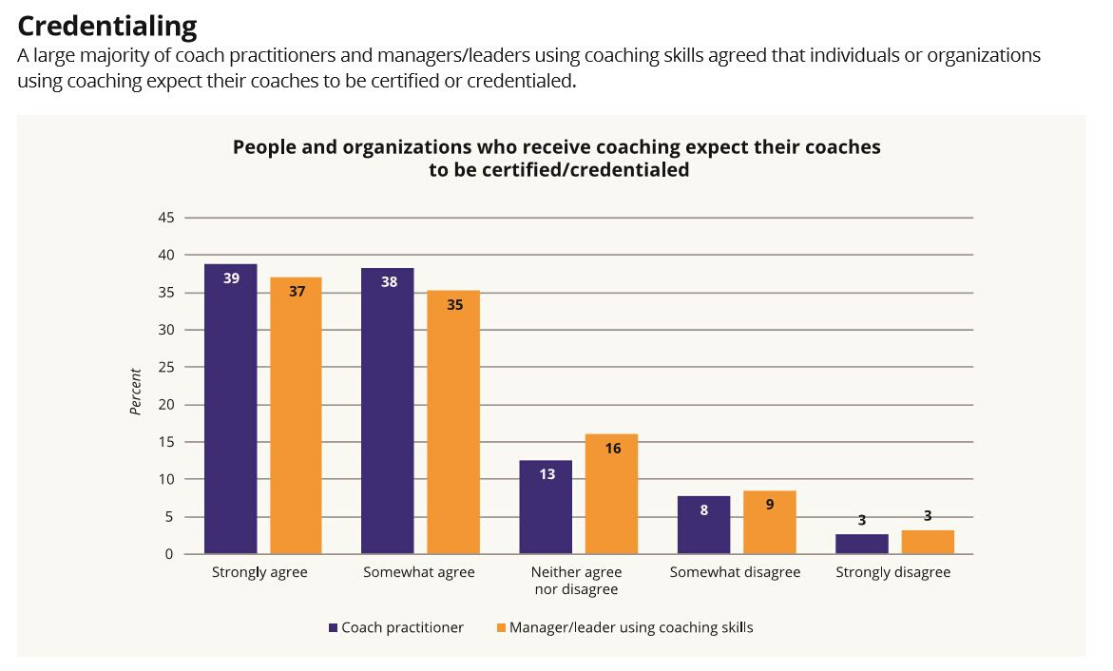

Slide 7

Resistance to Certification
FEAR OF
TESTING & OVERSIGHT
COMPLICATED APP. & RECORD KEEPING
01
03
05
TIME COMMITMENT
FINANCIAL
INVESTMENT
KNOWERS MIND
02
04

Slide 8
PROBLEM
READ
ACC
60 TRAINING HOURS
100 COACHING HOURS
ICF
Hours
Requirements
PCC
125 TRAINING HOURS
500 COACHING HOURS
MCC
200 TRAINING HOURS
2500 COACHING HOURS

Slide 9
PROBLEM
READ
ACC
CKA ONLINE TEST
SUBMISSION OF RECORDING
OR COMPLETE ACTP
ICF
Testing
Requirements
PCC
CKA ONLINE TEST
SUBMISSION OF RECORDING
OR COMPLETE ACTP
MCC
CKA ONLINE TEST
SUBMISSION OF 2 RECORDING
200 TRAINING HOURS

Slide 10
CoachVille's ACTP Program
  Three graduates certified as MCC in the past year!
  Electives and audio library gives you the 200 hours you need for MCC certification
  The environment of mastery gives you the depth and understanding to achieve MCC

Slide 11
Your business may depend on it!
The ICF Grandfather Clause.

Slide 12


An opportunity requires an ICF credential
No longer a matter of if, but rather of when.
We often have coaches calling, frantic for coach training.
" I have this great opportunity for XYZ company/organization, but they require an ICF certification.
How fast can I make that happen?"

Slide 13
Regulation and Legislation
No longer a matter of if, but rather of when.
That’s why credentials and associations like ICF are so important. ICF, with strict standards and self-regulatory guidelines in place, is a tremendous source of instant expertise and guidance to officials that may only think of the type of coaches that wear whistles around their necks.
In the 2016 ICF Global Coaching Study, 52 percent of coach practitioners said they believed that coaching should be regulated. Among those respondents (including both coaches and managers/leaders using coaching skills) not ruling out the prospect of regulation, 84% said that professional coaching associations were best positioned to regulate the industry.

Slide 14
States The ICF Watches Closely.
No longer a matter of if, but rather of when.
Regulation/Legislation
California
Texas
New York
Florida
Language - Psychology
Pennsylvania
Louisiana
Missouri

Slide 15
Top Five Reasons
Why Certification is Important
From the Perspective of CoachVille Students & Alumni
ETHICAL COACHING
MARKETING/BRAND
REVENUE
Sets us apart from those who hang a shingle out without training & Methodology.
Repeatable success.
An elite and professional status. Offers certainty
and comfort in a still growing field.
ICF Credential coaches reported revenue is continuing to surpass uncredentialled coaches, the gap is trending upward.
01
02
3
MASTERY
BUSINESS PRACTICE
If legislation or regulation happens, you do not want to scramble for certification in order to keep your practice open.
Far beyond accountability coaching to the core source of what needs to change in order to achieve.
05
04

Slide 16


Certification Applications
Link to Ethics
Link to Competencies
Link to ICF Studies
https://coachfederation.org/icf-ethics
https://coachfederation.org/core-competencies
coachfederation.org/icf-credential/
https://coachfederation.org/research/consumer-awareness-study

